Slide 1
What’s New in Microsoft Dynamics GP 2015 R2

Slide 2
Microsoft Dynamics GP Roadmap
2012
2013
2014 (H1)
2014 (H2)
2015 H1
2016 H1
2016 +
GP 2013
GP 2013 SP1/2
GP 2013 R2
GP 2015
GP 2015 R2
GP 2015 R3
Web Client
Functionality
Management Tools
Hosting
Business Analyzer (BA) on Windows
Web Client Wave Releases
Functionality
RapidStart
Business Analyzer Off Domain
On Azure
GP Workspace in Office 365
Functionality
Requisition Management
Identity Management V1
Workflow V1
Service Based Architecture (SBA)
Functionality
Identity Management V2
Workflow V2
BA on multi-platforms (Windows, Apple & Android)
All in One Doc Viewer
AP Inv Approval
Time Mgmt App
Automated Provisioning for Azure
Top features requested by customers
Enhanced user experience for Web Client
Multiple browser & device support for Web Client
Workflow enhancements
Top features requested by customers
Enhanced cloud deployment
Functionality and technology releases
Top features requested by customers

Slide 3
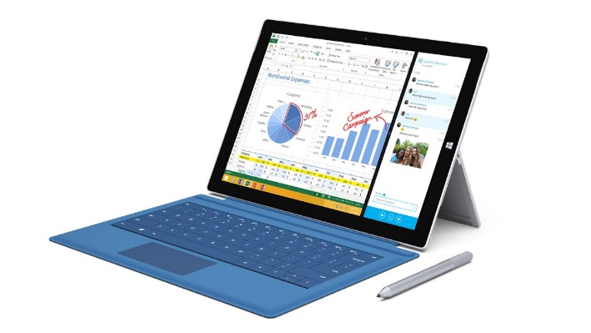












Dynamics GP 2015 R2
Microsoft Surface
Apple
iPad
Android
DEVICES
CRM
ERP
Bus Intelligence
Social Media
WORK
Service Based Architecture
Microsoft Dynamics GP
Microsoft Dynamics CRM
DEPLOYMENT

Slide 4
Dynamics GP 2015 R2 Feature Review
All-in-One Document Viewer – Purchasing
SQL View Designer
SmartLists Display Debits then Credits
SmartLists – Default New Favorites to User vs. System
Hide/Show SSN on Payroll & HR Reports
View W2
Combine GL Summary and Detail Inquiry Windows
Time Management App
Historical Received Not Invoiced Report
Auto Deposit Cash Receipts in Bank Rec
Visual Indicator for Customer Over Credit Limit
Enable Email for all Sales/Purchasing Forms (Short, Long, Other)
Self Service User Type
AP Invoice Workflow Approval
Workflow Document Attach

Slide 5
Business Intelligence

Slide 6
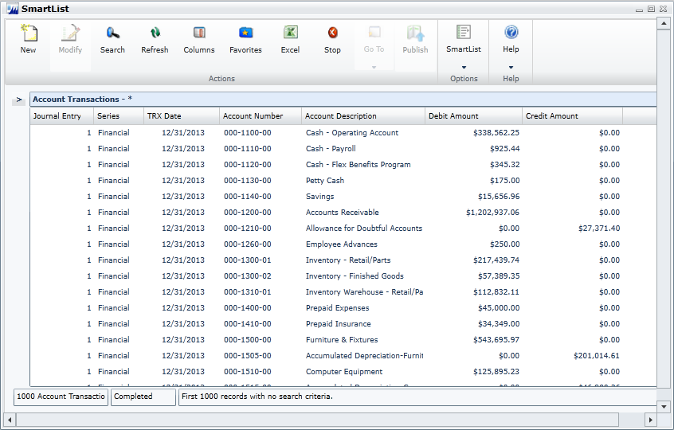
Display Debits before Credits
Debits before Credits in:
  SmartLists
  Excel Reports
  Database tables and views
Notes:
A top suggestion on the MS Connect site, this feature moves the Debit column to display before the Credit column by default in account transaction reporting options in which the Credit column previously displayed before the Debit column. This applies to SmartLists and Excel Reports, as well as the database tables and views on which the reports are based.

Slide 7
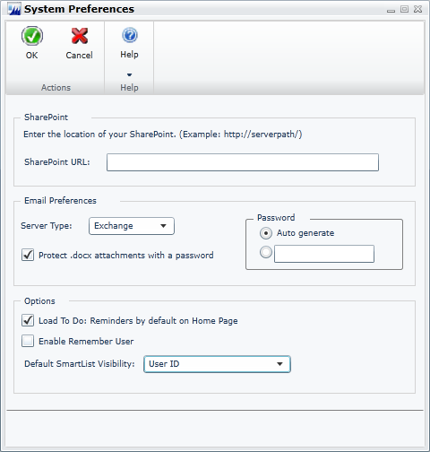
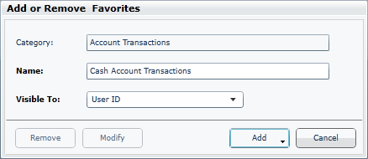
Default SmartList Visibility
Allow administrators to select the default visibility for new SmartList Favorites
Notes:
When creating a new SmartList Favorite, the user has the option to select to whom the SmartList Favorite will be visible, including the following options: System, Company, User Class, and User ID. System is the default option selected for the visibility. Typically when users create a new SmartList Favorite, they will simply accept the default visibility option, meaning that all system users are able to view the new Favorite. This leads to a large list of SmartList Favorites that are available to all users, which can create a cluttered mess that is difficult for system administrators to manage and clean up. This feature provides system administrators the ability to define the default selection for visibility when creating new SmartList Favorites. In the System Preferences window, we have added the Default SmartList Visibility drop-down list. The option that is selected here will be the option selected by default in the Visible To drop-down list when adding a new SmartList Favorite.
By adding the option to select a default value for the drop-down list, administrators can select to whom new SmartList Favorites, by default, will be visible, and make them visible by default only to the user creating the Favorite. This will help reduce clutter in other users’ SmartList Favorites, and allow administrators to more easily manage and clean up the lists.

Slide 8
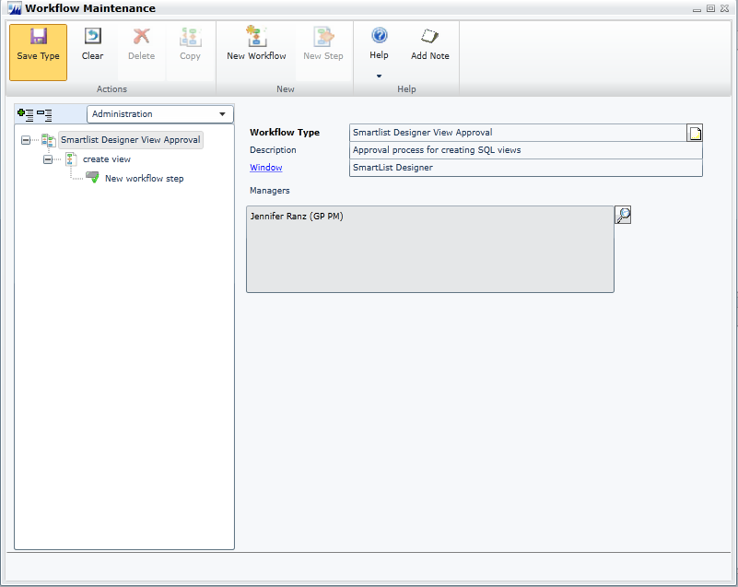
Create SQL Views using SmartList Designer Worfklow
Users can submit Smartlist Designer queries to workflow to create SQL views within the Company Database

Slide 9
Distribution

Slide 10
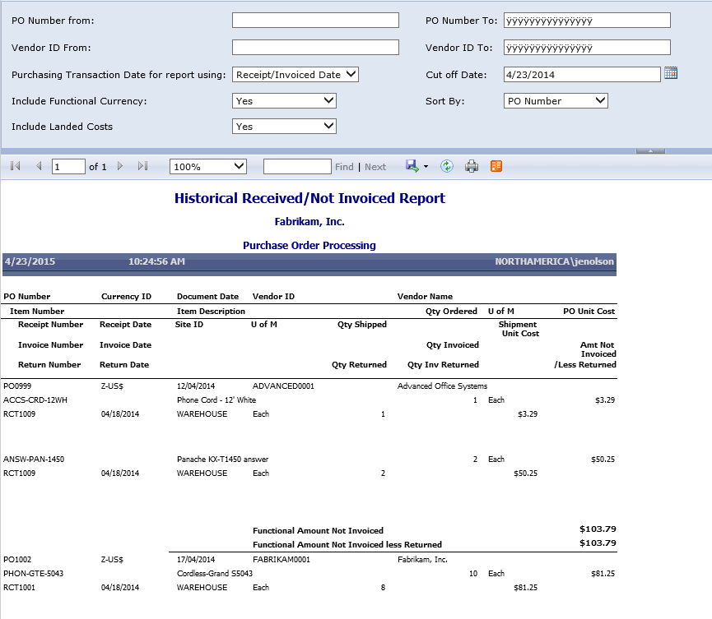
Historical Received-not-Invoiced Report
Created a new SQL Reporting Service Report to have a cutoff date based on transaction date or GL post date to allow customers to use the report for historical purposes.

Slide 11
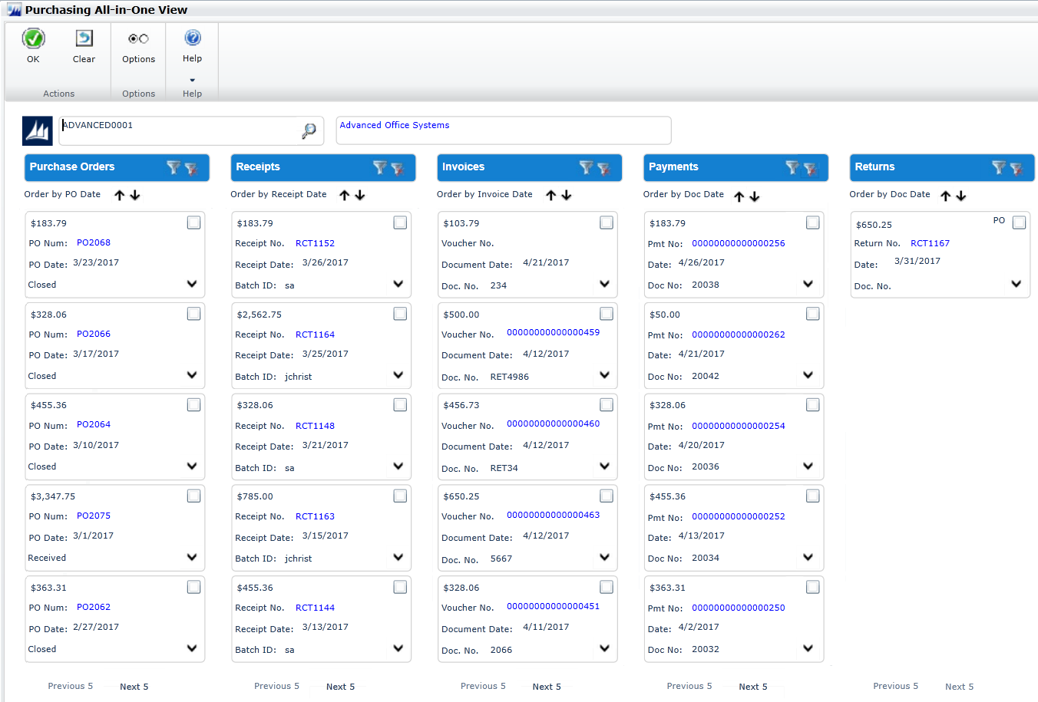
Purchasing All-in-One Document View
View all related purchasing documents for a single transaction in one window
  Select a purchasing invoice and window will refresh to show POs, receipts, payments, etc.
  Accessible from Vendor Maintenance, many purchasing inquiry windows, navigation lists and the home page

Slide 12
Financial

Slide 13
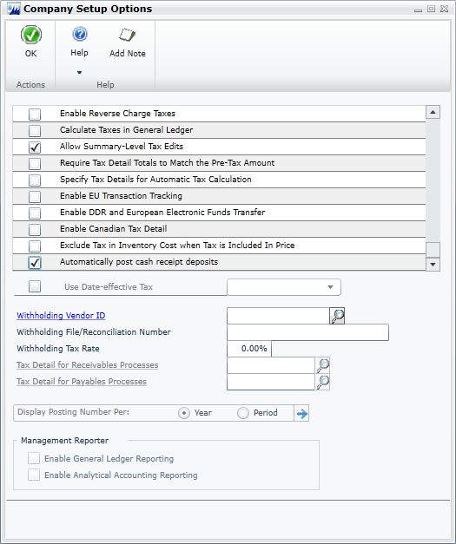
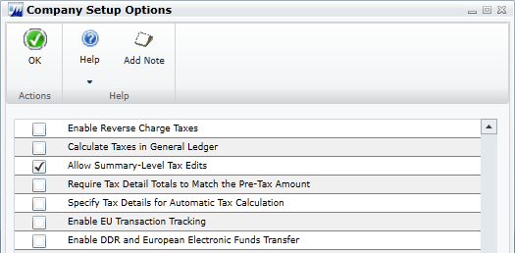
Automatically Deposit Cash Receipts
Cash receipt deposits are posted automatically
Notes:
This feature provides the option to have cash receipts directly update the checkbook balance without the need to manually post the cash receipt deposit in Bank Reconciliation. This option was previously available in Analytical Accounting. In Microsoft Dynamic GP2015 R2, the option is made available in the core dictionary, expanding the option to companies not using Analytical Accounting.
To select the option, mark the “Automatically post cash receipt deposits” checkbox in the Company Setup Options window.
When this option is marked, cash receipts entered in Cash Receipt Entry, Receivables Transaction Entry, Sales Transaction Entry, and Invoice Entry will be deposited automatically in the checkbook, updating the checkbook balance.

Slide 14
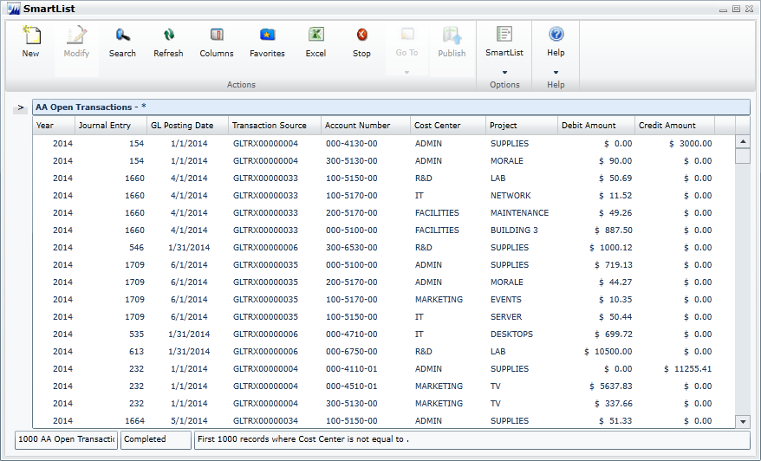
Analytical Accounting Transaction Lists
Lists include more data
Include a column for each transaction dimension
Improvements apply to:
  SmartLists
  Excel Reports
Notes:
This feature provides improvements to SmartLists and Excel Reports for Analytical Accounting (AA) transaction information. The first improvement is an expansion of the amount of information available to be included as columns in the AA SmartLists and Excel Reports. AA tracks a lot of information for each record, and we’ve included more of this data in the SmartLists and Excel Reports.
We’ve also improved the way the AA dimension code information displays in the lists. In prior releases, the lists contained a single column for the AA transaction dimension code. Thus, if the company is tracking more than one dimension on a transaction, multiple lines are required in the list for a distribution entry. In GP2015 R2, we’ve updated the SmartLists and Excel Reports to display a column for each transaction dimension, showing the code assigned for that dimension. For example, the screenshot shows how the list would display for a company tracking Cost Center and Project as AA transaction dimensions.
The change in how the data displays improves readability of the report, and also improves the ease with which users can summarize and work with the data in Excel using pivot table functionality.

Slide 15
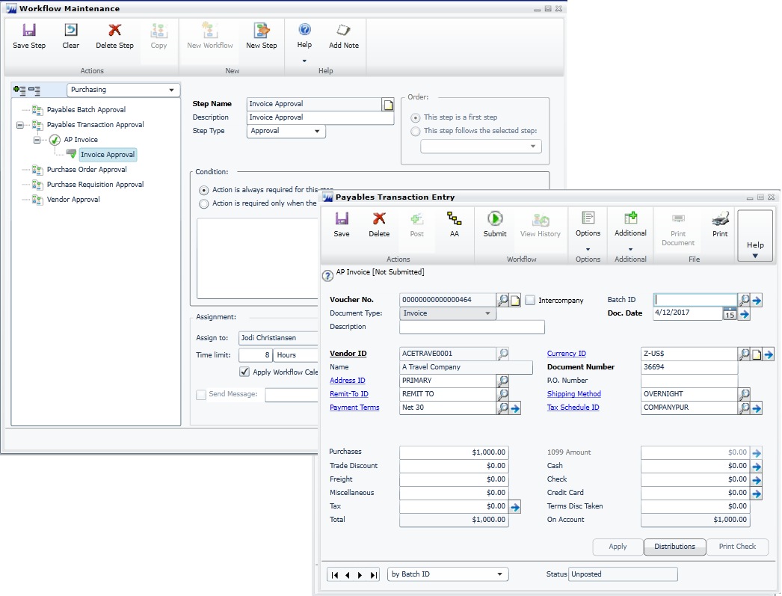
Payables Transaction Approval Workflow Type
Workflow approval for a single transaction in Payables Transaction Entry
  Define workflow process for Payables invoices, charges, credit memos, and returns

Slide 16
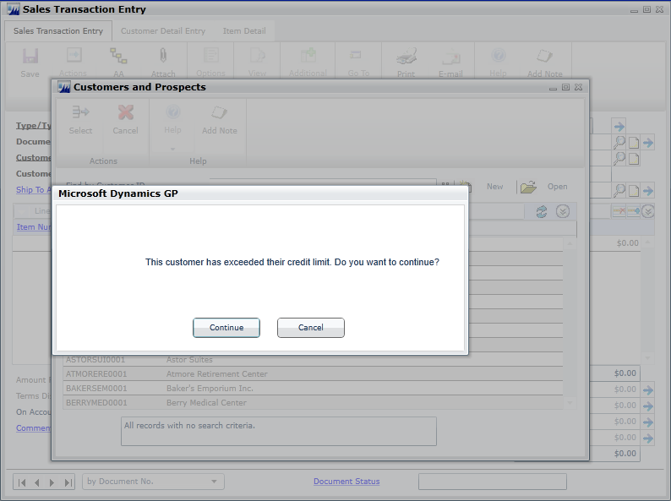
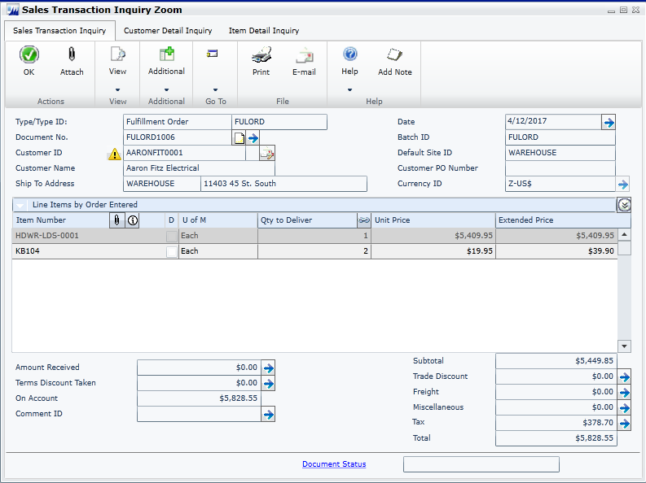
Visual Indicator for Customer Credit Limit
New options that determine how and when you are notified of a customer who is over the credit limit you set for them.
In Receivables Setup, you can select to display an icon or give a warning message for a customer who is over their limit.
Notes:
The existing process for an existing credit limit password will still be asked when entering a line item or saving a transaction.

Slide 17
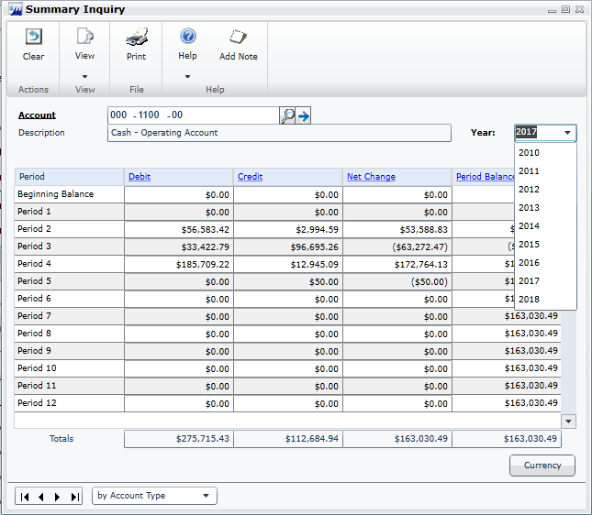
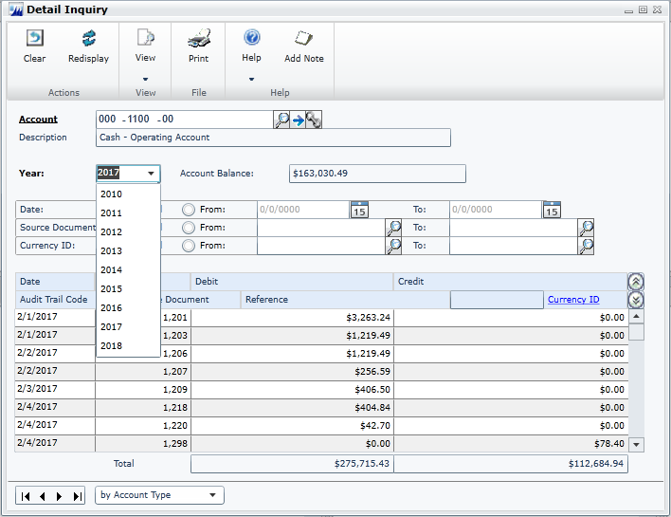
Combine Open and History Inquiries
View open and historical information in the same window for Summary Inquiry, Detail Inquiry and for Account Summary.
Any GoTo’s or drill backs will now go to the single window instead of the user picking open or history.

Slide 18
Human Resources and Payroll

Slide 19
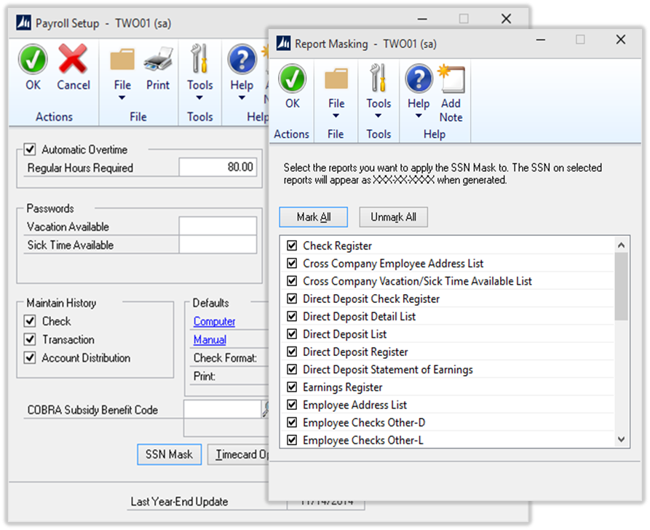
Mask SSN on Payroll and HR Reports
Masks the Employee Social Security Number on selected reports
  Select which reports you want to mask Social Security Number from the Report Masking window
  For selected reports, the Social Security Mask will appear as
  xxx-xx-xxxx when rendered
Notes:
Feature will provide an option for Mai, the Payroll Administrator, to mask the employee social security numbers on a predefined list of payroll reports. If Mia selects to apply the mask for a particular report, when generated, the employee social security number field on the report will appear with a XXX-XX-XXXX mask.

Slide 20
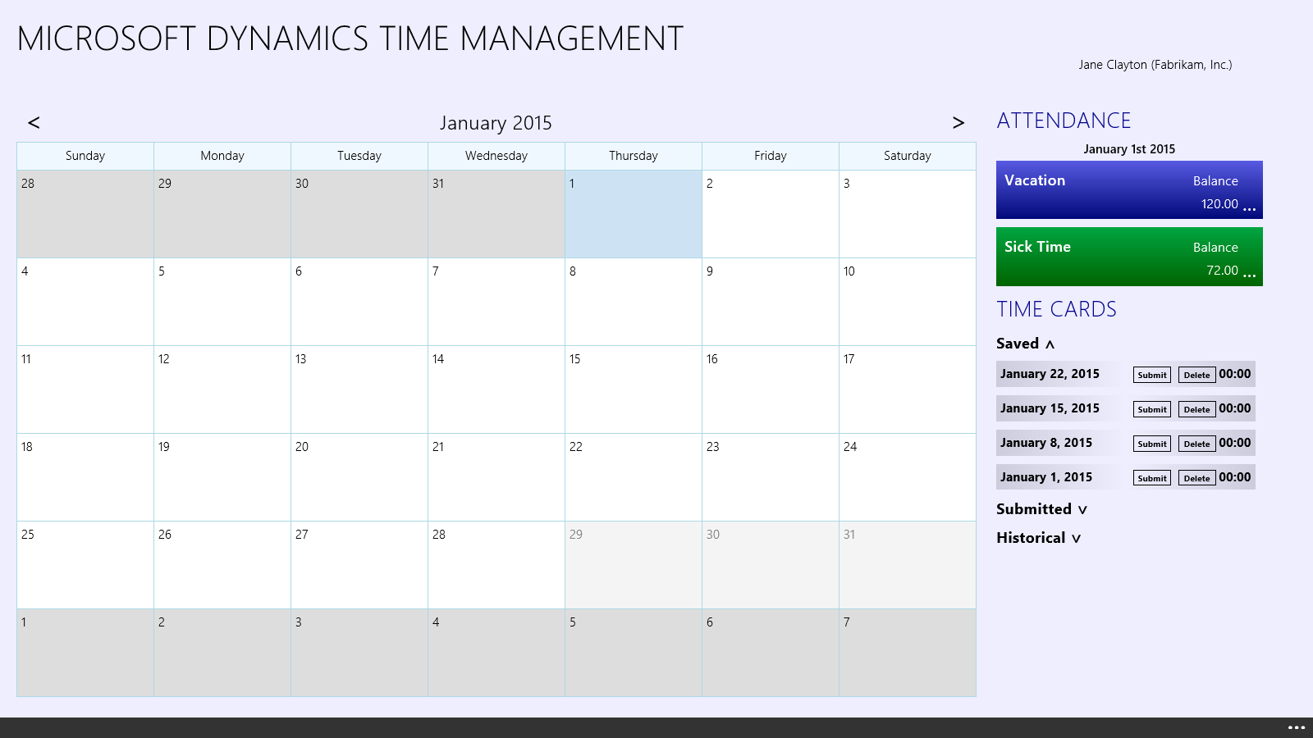
Time Management App
The time Management app will allow GP Employees to enter Vacation and Sick time in Payroll or time off against Benefit Timecodes within HR. The app is available for Windows 8, iOS iPad devices, and Android tablets.

Slide 21
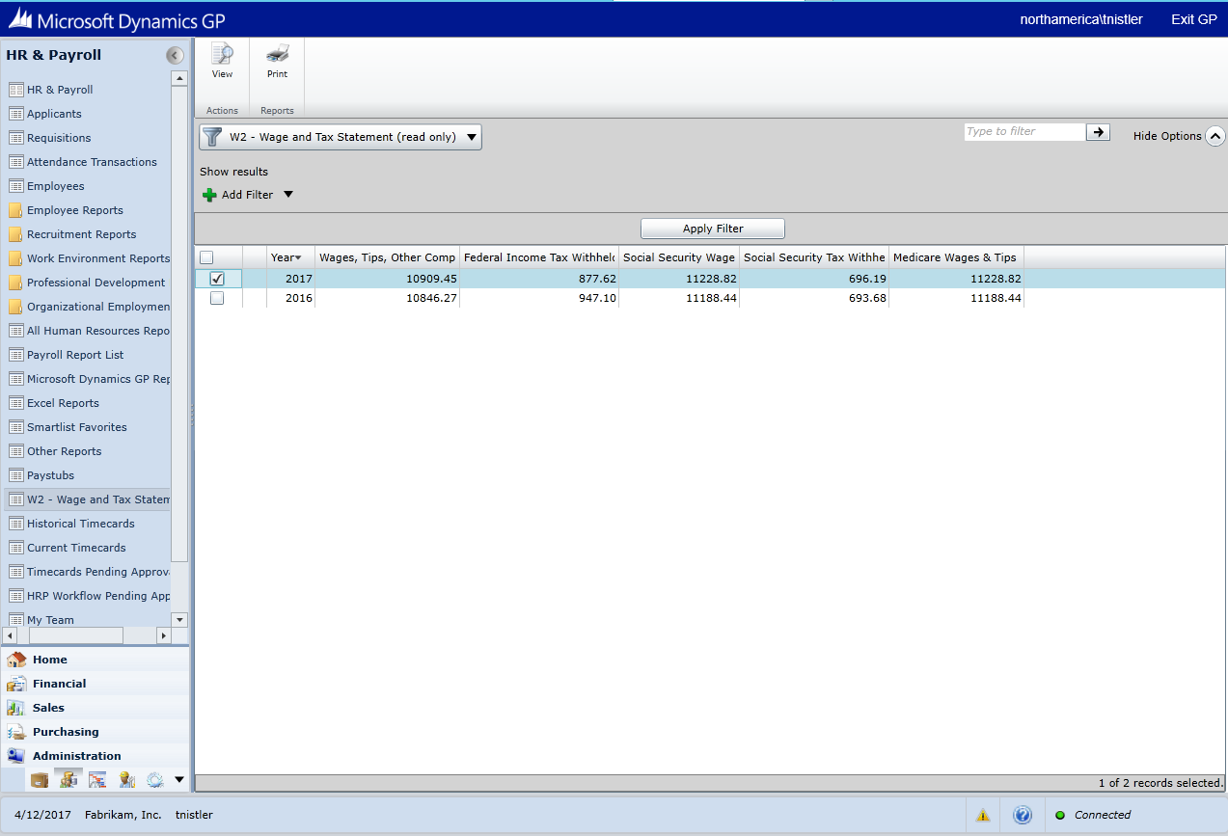
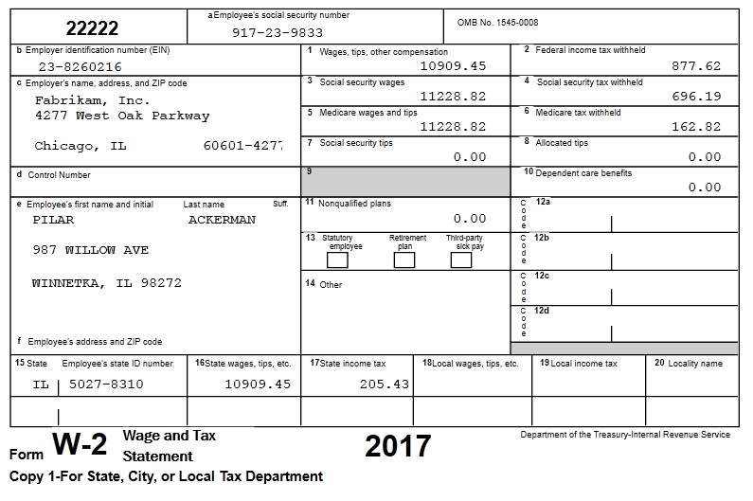
View W2 for ESS
With Employee Self Service W2, the employee can now view and print their own W2.
The action will display on the Time Management home page part.

Slide 22
System

Slide 23
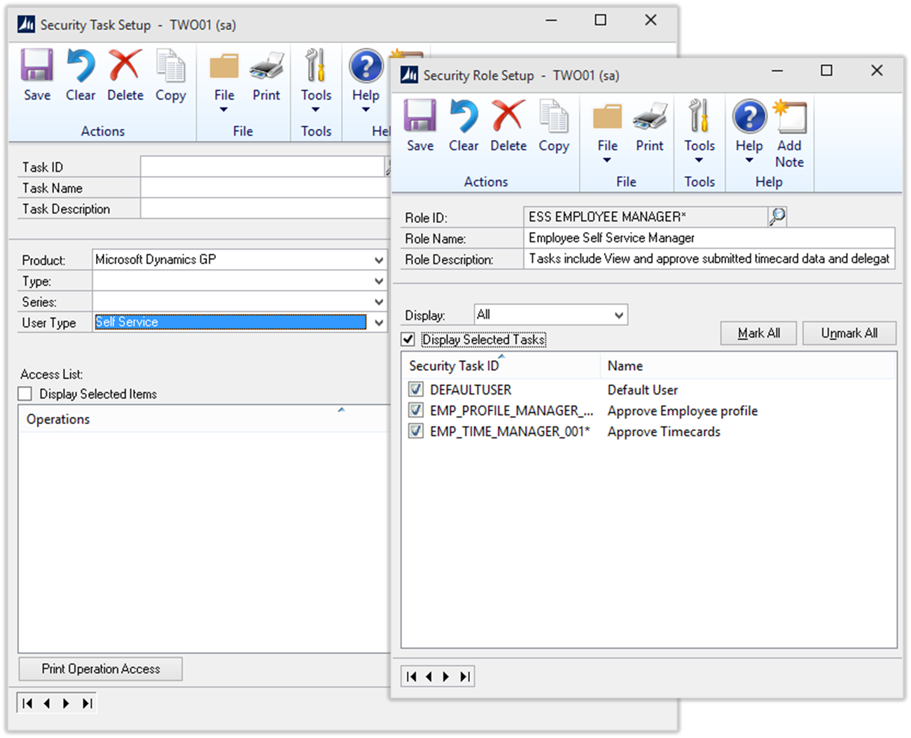
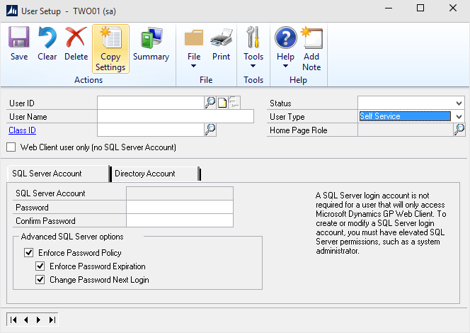
Self Service User License
Support for an additional user type of Self Service
  Limits the navigation and functionality to essential tasks the self service user will need
  Security roles tailored to the Self Service User Type
  Enables user to quickly filter tasks that are available to each user type
Notes:
In GP2013, we added user types: Full and Limited User but the pricing and functionality between these 2 user types was identical. In GP 2013 R2 our licensing changed and we begin pricing the user types differently and thus released a feature to restrict access based, not only on security setting, but also based upon user types.
In GP 2013 R2 and GP 2015 we released functionality in Dynamics GP to enable self-service type functionality, that before, was only available in the Business Portal, in order to support the strategy to deprecate the Business Portal. With this came a need for additional pricing options because customers were not happy with being charged $600 (Limited User License fee) for self-service tasks that were either free, or offered at a very low price, in the Business Portal.
In 2015 R2 release we will be adding another user type of Self Service. This user type will be added to enable users that only require very limited access to the system a less expensive option to perform tasks such as entering payroll time, entering project time and expenses, or creating a requisition.

Slide 24
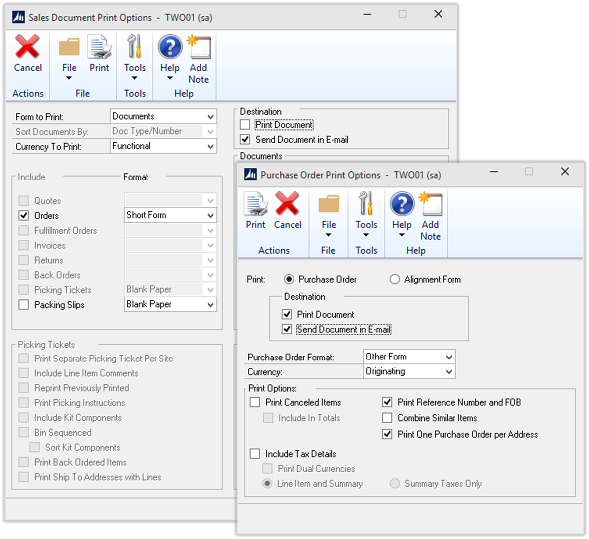
Enable Email on Report Options
Enables email support for all document formats
  Supports all Sales Order Processing document formats
  Blank
  Short
  Long
  Other
  Supports all Purchase Order Processing document formats
  Blank
  Other
Notes:
The Print Options for Purchase Orders currently only support email for ‘Blank’ document formats. This feature will support email for any document format for all Purchase Order documents.
This feature is supported when printing from the Transaction Entry Window, Navigation Lists, and Print Purchasing Documents window.

Slide 25
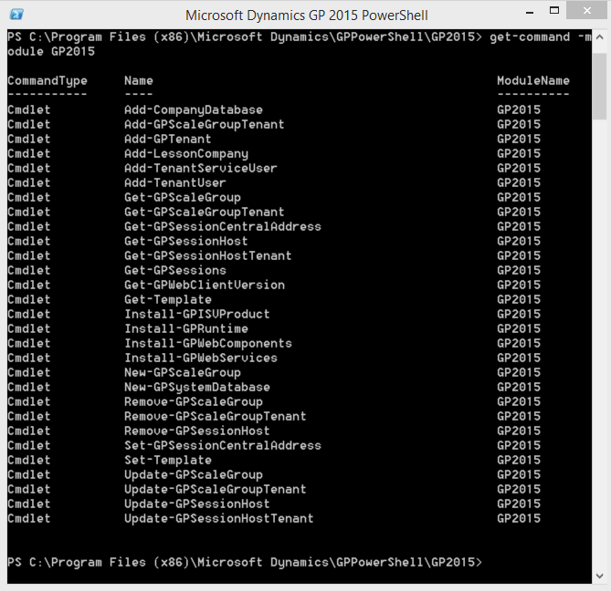
Scriptable GP Provisioning and Management
PowerShell cmdlets
  Install (GP components)
  Configure (create databases, add tenants)
Templates
  Set parameters
  Override with run specific parameters
Remoting
  - Execute cmdlet on remote computers
Notes:
The scriptable GP provisioning and management feature adds additional cmdlets to the Microsoft Dynamics GP 2015 PowerShell module for installing and configuring GP. These include cmdlets for installing the GP runtime, Web Components, Web Services and ISV products. It also includes cmdlets for creating a new GP System database and adding companies along with adding tenants to a multitenant deployment.
You have the ability to create templates with set parameters to improve consistency and efficiency. An example in using a template would be a Service Provider creating templates for different offerings that include modules and ISV products to install. The Service Provider then uses the template along with the tenant specific configuration to provision a new tenant.
The provision and management can be performed on the local machine or can be performed on remote computers using PowerShell remoting functionality. Enabling centralized management scenarios.

Slide 26
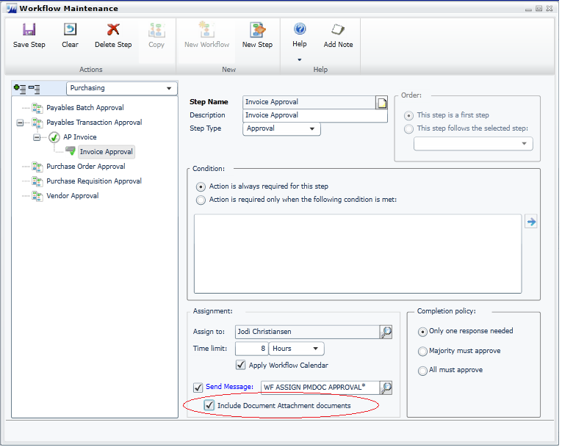
Document Attachments for Workflow Email
Send Document Attachments files with workflow task notification emails
  -Scan payables invoice and attach it to the transaction
  -Submit through workflow
  -Workflow notification email will have scanned invoice attached along with pertinent details of payables invoice for the approver

Slide 27
Dynamics GP 2015 R2
All in One Document Viewer Demo

Slide 28
Azure. Web Client. Apps.

Slide 29

Microsoft Dynamics GP on Azure
Azure Cloud
On-Premises
OS
SQL Server
Hardware
OS
SQL Server
Pre-Configured
Domain
Web Server
Reporting Server
Domain
Web Server
Reporting Server
Dynamics GP
Dynamics GP
Notes:
A move to a private cloud in Azure is straight forward. It would involve backing up the GP databases and SQL logins on-premise. Setting up a SQL Server in Azure and restoring the backups. Setting up the other server components (i.e. Domain Controller, Web Server and optionally a reporting server) and installing Dynamics GP.

Slide 30


Estimating Azure Costs
Determine number and size of servers required
Determine storage requirements
Estimate outbound data transfer
Acquire licenses
Monthly cost estimate for a 15 user web client deployment.
Web Server (A2) = $133.92
SQL Server (A2) = $133.92
(SQL license mobility)
Active Directory = $ 66.96
Total/month = $334.80
350 GB = $16.25
(locally redundant storage)
15 GB = $1.20
(1GB/user/month)
GP - Purchase perpetual, subscription or SPLA licenses the same as you would for an on-premise deployment.
SQL – Purchase SQL Server license with license mobility under Software Assurance.
Total/month = $16.25
Total/month = $1.20
Notes:
It’s helpful I think to understand what powers the web client on the backend. There are four main services that operate to launch and deliver the webclient to the browser. These are Session Central, Session Service, Runtime Service and Tenant Service.
Session Central – this service operates as the gateway to the web client, it primarily determines what session host machine will host the web client session.
Session Service – Session Service manages running processes on the machine it is running on. It communicates with Session Central to receive new session requests and to inform Session Central of the status of sessions like when they have been terminated by the user.
Tenant Service – Tenant service manages the web client users and the tenancy they are part of by providing user and start up parameters for creating sessions. It is only present in multi-tenant deployments.
Lastly a fourth service called the Runtime Service wraps the dexterity process and handles communication between it and the Web Client Silverlight app running in the browser.

Slide 31
Microsoft Dynamics GP Web Client
The web client effort focused intently on reducing hosting costs while maintaining the quality user experience and extensibility customers expect
Performance is comparable to Terminal Services and web client scales better
ISV applications will work
Same business logic is used for web and desktop clients
Support for “Mixed Mode”.
Support for BOTH desktop client and web client on the same server
Notes:
Some of the most common questions we get about Web Client:
Will ISV applications work? Yes—web client utilizes the same application code and artifacts as the desktop client.
What is the performance like?
Application performance is comparable to terminal services. Web Client however scales better than terminal services.
Can I run web client and the desktop client in the same environment? Yes—you can even run them on the same server.
Or, in marketing speak, “The web client effort focused intently on reducing hosting costs while maintaining the quality user experience and extensibility customers expect”

Slide 32

Web Client Security
Encryption
  Fully encrypted login
  All client–server interactions
  Optionally between services
  Https/Secure Sockets—certificates required
Windows or Azure authentication
  Single login to landing site and Microsoft Dynamics GP
  Mitigates Denial of Service attack
Microsoft Dynamics GP security remains
Notes:
What about security?
Traffic between the browser and related services supports SSL encryption.
Since Web Client is built on top of Dynamics GP; the underlying application security is the same.
In 2013 R2 and later you have the capability to map a windows or organizational account to a GP User. Doing so allows for a ‘single login’ experience when singing in with web client.

Slide 33



Web client for You
Acquire
Changes how
we work
65% of companies are deploying at least one social software tool
Deployment options that fit customer needs
Small
Large/Multi Tenant
Single server deployment for customers with less than 20 users
Quickly scale to hundreds of users by adding additional servers
On-premises or cloud
Notes:
Web Client can be deployed in a number of different ways depending upon various needs and desires.
The quickest and easiest way to be up and running is to use a single machine configuration. This scenario is perfect for less than 20 simultaneous Web Client users and is well suited for demoing GP. We‘ve also customized an installation wizard to help streamline this deployment option.
If you’ve got the need for more than 20 simultaneous users another option available to you is what we call a ‘Scale Out’ deployment. This option allows you to easily add capability for more users simply by adding more service based machines. As a general rule of thumb, each of these added machines in this configuration are generally capable of handling 60 users per 8 GB of RAM.
What if you don’t want (or can’t) go with a Web Client only installation? Well, both large and small deployments will work with BOTH the Desktop Client and the Web Client; we refer to this as a “mixed mode” deployment.
Any of these deployment models can further be deployed on premise or in the cloud. If you’ve already made hardware and infrastructure investments Web Client is perfectly suited to that environment.
On the other hand if you’d like to minimize up-front hardware, infrastructure, and related maintenance costs a cloud deployment is an excellent choice. We’re partial to Windows Azure; however we have also tested Web Client on provider platforms from Amazon (AWS) and RackSpace.
In addition to all of this, if you’re hosting GP for many customers or if you’d like to segregate users by different GP configurations—we introduced multi-tenant database support with GP2013. This allows you to use a single SQL server installation, further reducing your costs.
With all of these deployment configurations available to you, you really can have “web client your way”.

Slide 34
Customizations for the Web Client
Reuse
Simplicity
Flexibility
Dynamic Rendering
Custom VST Code
Modified Reports
Modified Forms
Alternate Forms
Third Party Products
- Dictionaries
- VSTools Addins
Ideal for complex controls
Access client hardware and devices
Notes:
Web client itself is customizable…
The success of GP relies heavily upon the customer, partner, and ISV ecosystem to add additional functionality to what is provided out of the box. A Web Client that would only provide ‘out of the box’ functionality likely wouldn’t be too well received. Thus, we worked hard to come up with a customization architecture that would meet three basic goals:
Allow maximum reuse of existing code (runtime engine, sanScript, managed add-in’s)
In areas where reuse isn’t possible nor practical, make it rather simple and straightforward to expose ‘typical’ functionality
For all that remains, allow for the flexibility of implementing the more customized (‘non-typical’) or advanced scenarios.
Ultimately we came up with two approaches to satisfy all three goals: Dynamic Rendering and Custom Visual Studio Tools Code.
We leverage dynamic rendering to display Dexterity based forms and reports within the Web Client. In other words, pretty much all Dexterity based artifacts come along and are rendered “on the fly” within the Web Client. But you might be thinking, what about managed add-ins? Well, it turns out that our dynamic rendering approach can actually be applied to many VSTools addins. But now wait a minute, one can do all sorts of crazy things within a managed add-in, right? Yep—so we surveyed the landscape and said hey, within all that craziness there’s still a fair amount of ‘non-craziness’—and for that we make it simple to ‘register’ non-crazy items to be enabled within Web Client.
For everything else (whether it be ‘craziness within a managed add-in’, custom VBA modifications, etc…), we provide rather thorough documentation that gives a developer the ability to author truly custom Web Client extensions.

Slide 35
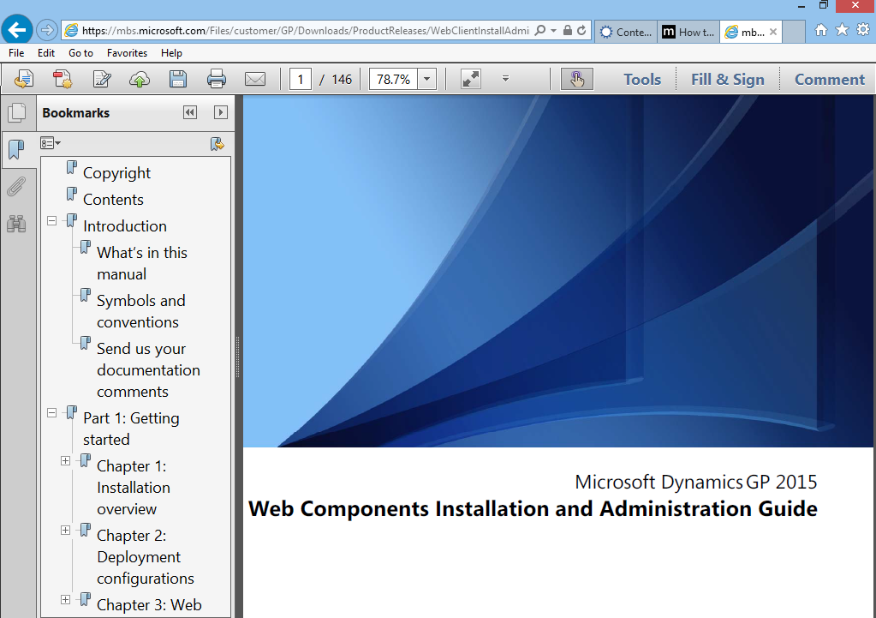
Deployment guides
2015 documents up to date
Installation Guide includes Service Based Architecture
Hosting and Deployment White Paper
Notes:
Lastly, we’d like to plug our documentation. For more information on Web Client and the deployment options available to you take a look at the installation guide. If you’re interested in hosting, we also produce a white paper specifically tailored to that experience.

Slide 36
Dynamics GP Device Apps & O365
Productivity
Business Apps
Platform
Notes:
Breaking down barriers
our unique approach erases the lines between sales and marketing, between IT and business, etc.
our products and services spans on-prem, public cloud, private cloud… no one else can offer this to you
end-to-end applications to enable end-to-end business processes, front end and back end, all connected
As a productivity and platform company, Microsoft’s passion is to enable people to thrive in a mobile-first, cloud-first world. Business solutions are core to Microsoft’s delivery of digital work experiences, transforming how people work and reinventing business productivity.

Slide 37



Dynamics Business Analyzer 7
Windows 8 Tablet
Initial Release Jan 2013
Release 7 July 2014
Excel, SSRS and MR content
Available in Windows store
Apple iPad
Initial Release Sep 2014
Excel, SSRS and MR content
Available in iTunes store
Android Tablet
Initial Release Oct 2014
Excel, SSRS and MR content
Available in Google Play store

Slide 38
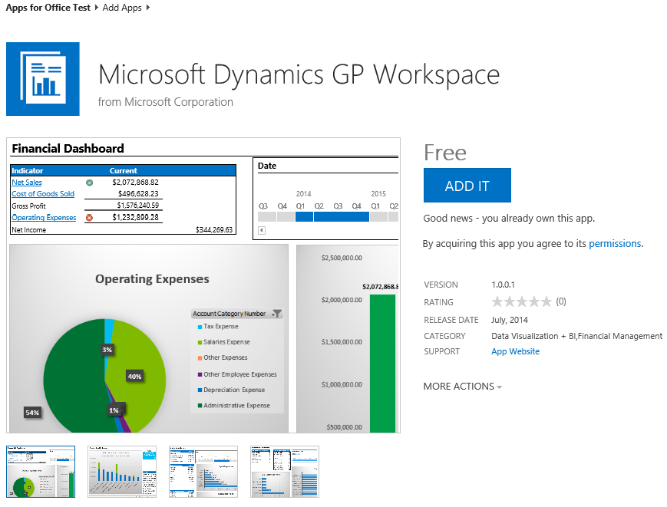
Dynamics GP Office App
Microsoft Excel-based dashboard information in Microsoft Office 365 SharePoint Online
View Microsoft Dynamics GP information for
  Financial
  Sales
  Inventory
  Purchasing
Refresh data and drill to details in Microsoft Dynamics GP
Available in the Microsoft Office Store

Slide 39

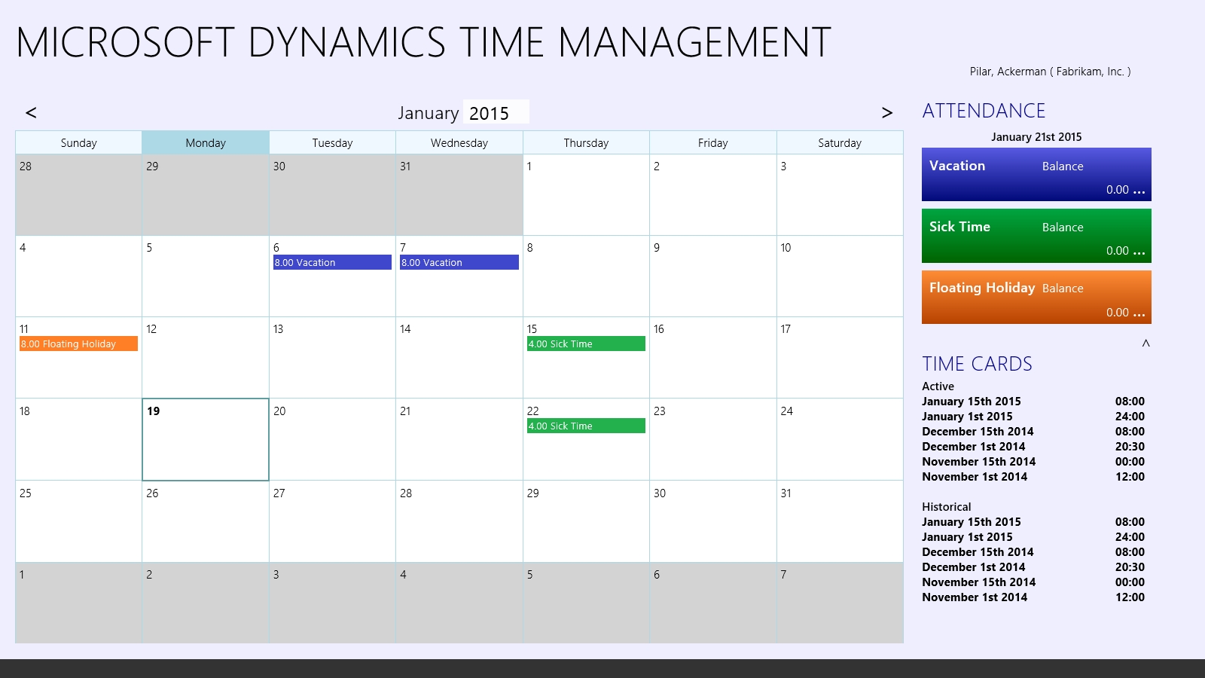


Dynamics GP Time Management App
Windows
Tablet
Apple iPad
Android Tablet

Slide 40




Workflow
Moved to the Web Client
Removed SharePoint Dependency
Improved Design Experience
Increased Flexibility
Notes:
GP 2013 R2 introduces a completely new workflow system. We’ve removed our dependency on SharePoint, improved the design experience, and now have a completely integrated workflow system. We not only provide out of the box workflow types but allow developers to define and add their own.
There is no workflow specific licensing. Access to workflow capabilities is simply based on user/window level security within GP. As long as a person has access to a window which contains workflow functionality, they have access to workflow.

Slide 41
Workflow Types
Dynamics GP 2013 R2
  Purchase Order Approval
  Purchase Requisition Approval
  Payroll Timecard Approval
  Project Timesheet Approval
Dynamics GP 2015
    General Ledger Batch Approval
    Receivables Batch Approval
    Payables Batch Approval
    Vendor Approval
    Employee Profile Approval
    Employee Skills Approval
    Direct Deposit Approval
    W4 Approval
    Project Expense Report Approval
Notes:
In addition to redesigning workflow in GP 2013 R2 we released with 4 workflow types. In GP 2015 we added an additional 9 workflow types and will look to add more in future releases as the need arises.
In GP 2013 R2 you still have the ability to use the prior (SharePoint) based workflow. However, in GP 2015 that workflow system will no longer be available.

Slide 42
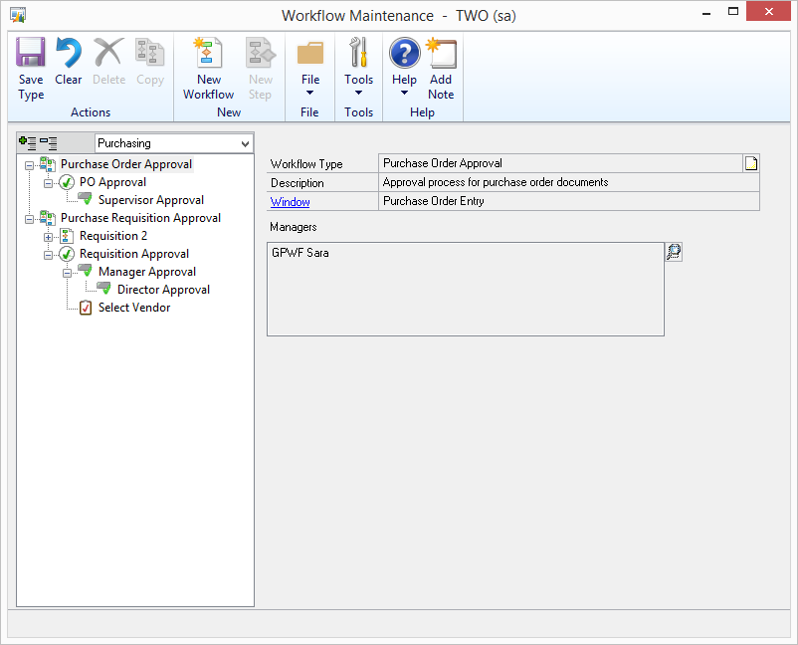
Type
Maintenance
Notes:
Defining a workflow begins with identifying the type of workflow to be created. Workflow types are grouped by module / series and are linked to a window / document type.
A workflow manager is assigned to a workflow type. The manager is the ultimate authority on any workflow associated with the type. He / she can change and alter steps and has approval and completion authority over any step of the workflow.

Slide 43
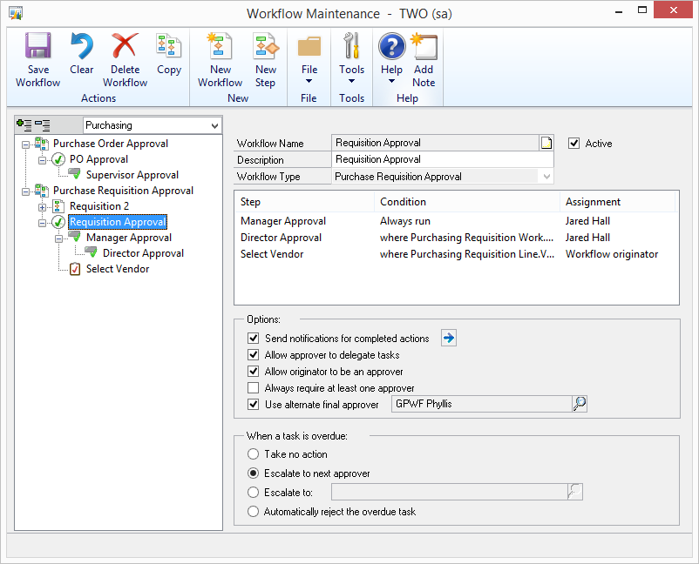
Workflow Maintenance
Notes:
Each workflow type may contain any number of workflow definitions; however only one workflow may be active for any single workflow type.
A workflow definition is comprised of any number of individual workflow steps (which we’ll see in more detail later).
Workflows can be configured to:
- send notifications to the originator on completed workflow actions
- allow approvers to delegate their responsibilities
- allow the originator to also be an approver (if unchecked the originator of the workflow may not be an approver of their workflow)
- ensure that at least one approver is always involved in approving the workflow
- use an alternate final approver (which acts as an intermediary before the workflow manager).
A workflow definition may also be configured to take certain actions when any of its tasks become overdue:
- take no action (which essentially ignores any time restrictions)
- escalate to the next approver within the workflow
- escalate task to a named entity
- or simply reject the overdue task

Slide 44
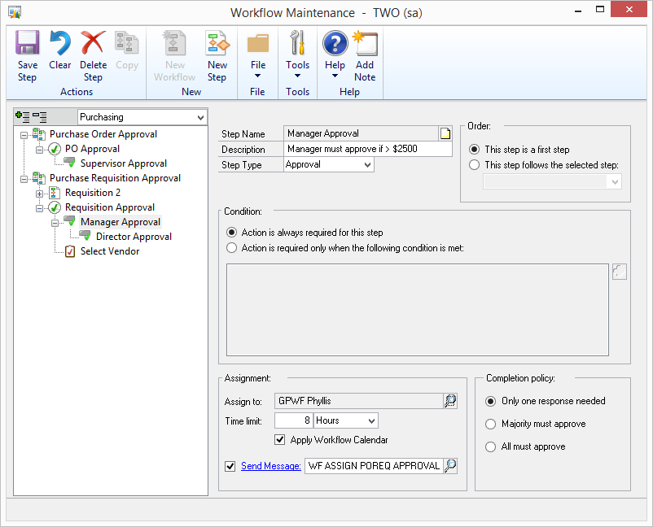
Step Maintenance
Notes:
Two types of steps can be associated with a workflow:
1) Approval (in which an approver can choose to ‘approve’, ‘reject’, or ‘delegate’ the step)
2) or you can have a task (in which a person can mark the assigned task as ‘task complete’
Steps themselves may be nested beneath other steps in a hierarchical fashion and may be defined with conditions required for step execution.
In either case a step is assigned to an active directory entity and may include a time limit for action completion. The time limit can take into consideration the ‘workflow calendar’ which allows you to define work hours and work days over which the time limit should be incremented.
Optionally the step may send a workflow assignment notification to the entity assigned to the task. That notification is template-able and we’ll attempt to provide an appropriate default.
Should the active directory entity assigned to the step represent a group, the completion policy options allow you to specify how many responses are needed to satisfy the task.

Slide 45
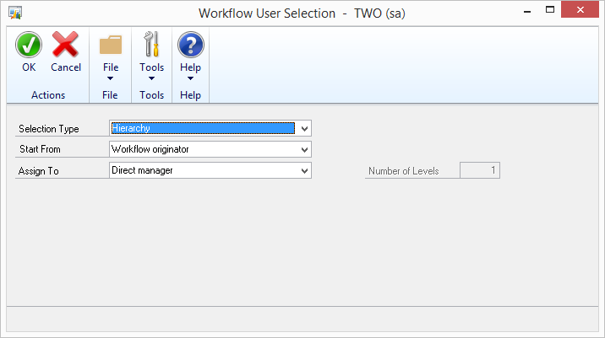
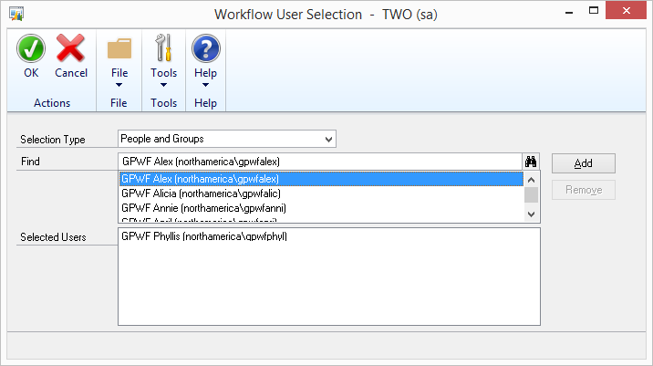
Workflow User Selection
Selection Types:
  AD User(s)
  AD Groups
  AD Hierarchies
  Workflow users
Notes:
An active directory entity as it pertains to workflow can be a user, group, or individual entities defined within a hierarchy.
Why active directory? Well, we didn’t want to require workflow approvers to be actual GP users.

Slide 46
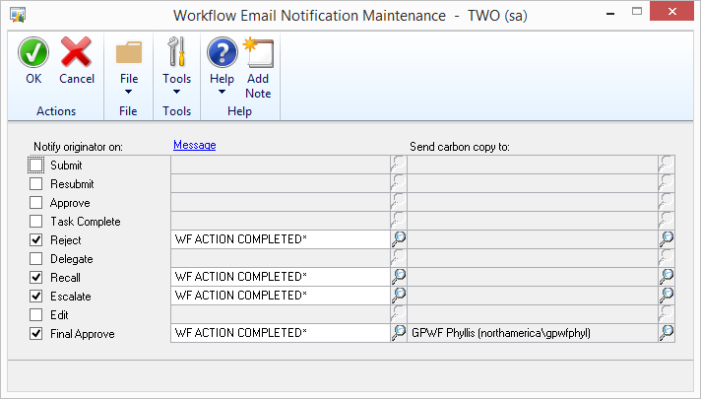
Workflow Options
Send notifications for completed actions
Notes:
We talked about workflow notifications on completed actions. This window allows one to specify which individual workflow actions should provide a completion notification. These notifications are also template-able and can be carbon copied to one ore more active directory entities.

Slide 47
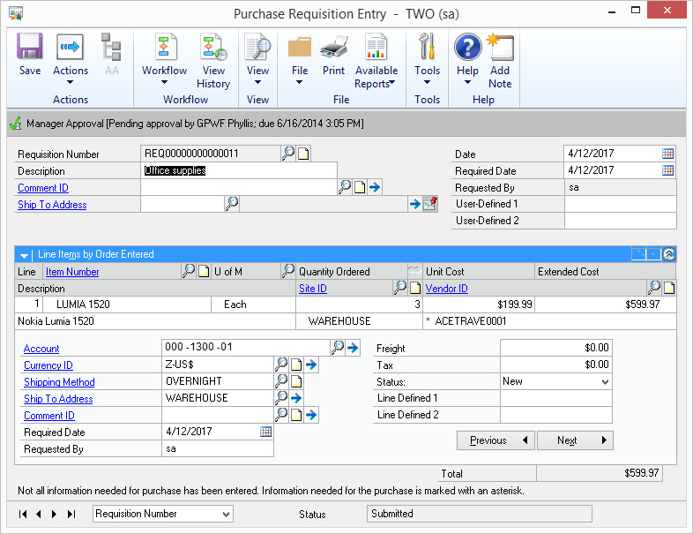
Transaction Entry
Notes:
Here’s an example of how workflow assignments can be presented.
Because a workflow type has been configured for this window we have a workflow group in the ribbon. The group displays those actions available specifically to the user for interacting with the workflow.
Additionally, just below the ribbon a workflow info bar is available which shows the current workflow status of the document. If there is more than one pending step, buttons will appear that will allow one to scroll through the pending workflow steps for the document.
To see all the steps taken on the active document we can view history of the active workflow…

Slide 48
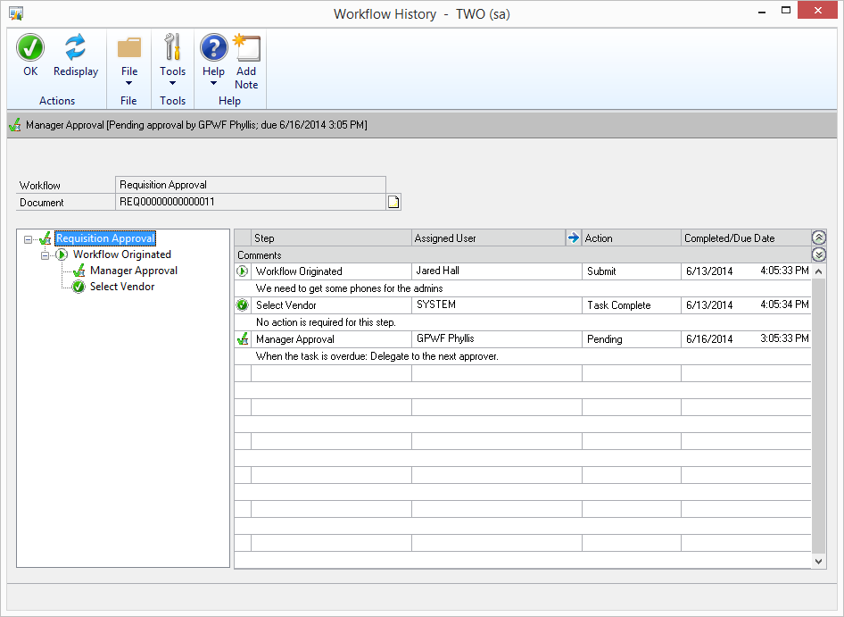
Workflow History
Notes:
While viewing workflow history one can click through the various steps and see what’s been done up to this point for the document.

Slide 49
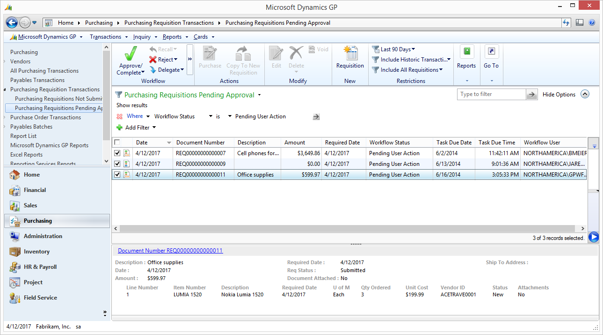
Notification and Action
GP Navigation Lists
Notes:
Workflow actions can also be taken against multiple workflow tasks via a navigation list.
Simply select the documents you’d like to apply the same workflow action to and then select the appropriate workflow action.

Slide 50
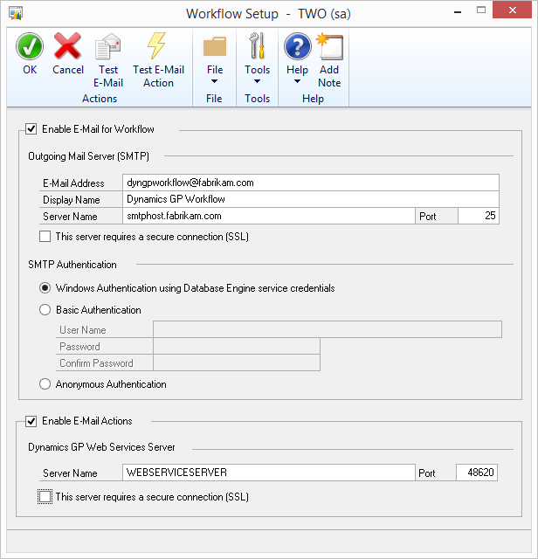
Workflow Setup
Notes:
Workflow can be enabled with or without e-mail.
If you enable e-mail notifications for workflow you can also choose to allow users the ability to take workflow actions from links within that e-mail. Doing so requires GP Web Services to be deployed and configured.

Slide 51
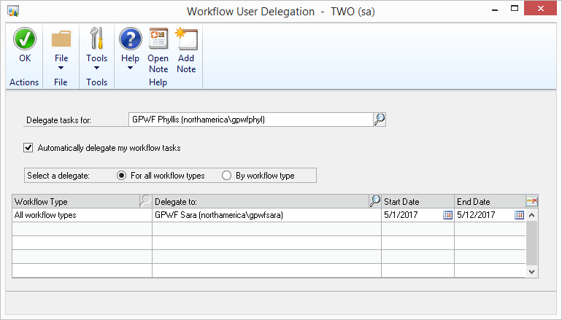
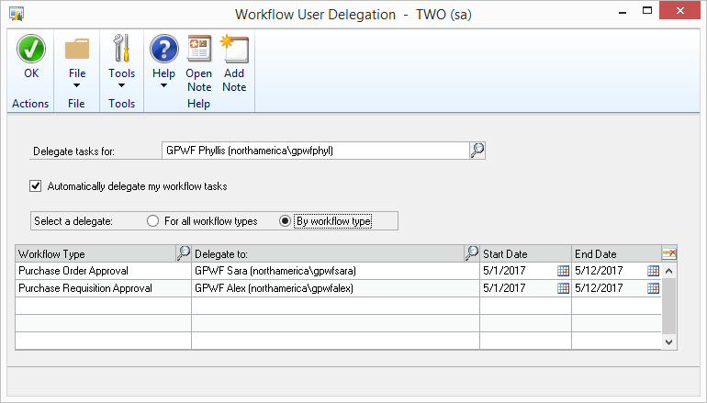
Out-of-Office Delegations
Notes:
Lastly, if a user is assigned various workflow tasks but he/she is going to be out of the office; they can use the Workflow User Delegation window to delegate their workflow tasks to others.
Delegation can be defined based on all or individual workflow types and includes the timeframe for the delegation.

Slide 52
Dynamics GP 2015 Feature Highlights

Slide 53
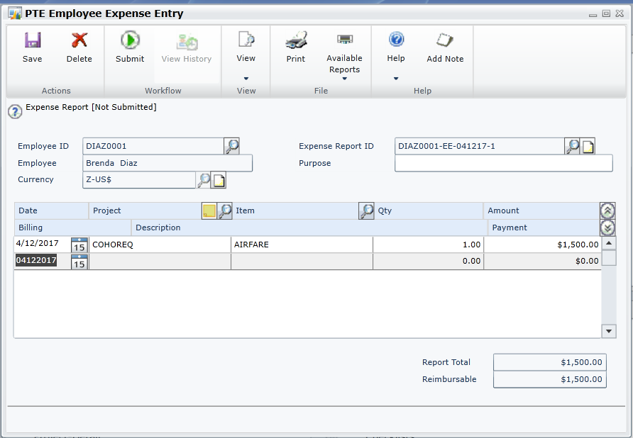
Project Employee Expense Report
Project Employee Expense Report and Project Timesheet Entry replace all of the functionality of both Business Portal T&E and PDK!
Notes:
Project Employee Expense Report and Project Timesheet Entry replace all of the functionality of both Business Portal Time and Expense and PDK.
Users also have the capability to add notes.

Slide 54
Top Feature Review

Slide 55
Financials
Dynamics GP 2013 SP2
Display Checkbook ID on Cash Receipts Inquiry
Customer Combiner & Modifier
Vendor Combiner & Modifier
Payables Void Enhancements
Reconcile Checkbook without Marking Transaction
AA Finance Charge Assessment
AA and Sales Order deposits
Dynamics GP 2013 R2
Copy and Paste to GL
Roll Down Account Segment Description
Reverse Fiscal Year
Reprint Outstanding Transactions Report
Default Sort order for Payables Checks
Payables Transaction Document Attach
Default Asset ID from Fixed Asset Class
Integrate Multi-currency Revaluation with AA
Dynamics GP 2015
General Ledger Batch Workflow
Payables Batch Workflow
Vendor Approval Workflow
Receivables Batch Workflow
Intercompany enhancements
Fixes Assets Year End Close Report
Edit E-mail for historical Statements and Payables Remittance

Slide 56
Distribution
Dynamics GP 2013 R2
Suggested Item Enhancements
Assign Item to Multiple Sites
Purchase Requisitions
Purchase Requisition Workflow
Purchase Order Workflow
Prepayment Additions
Encumbrance SSRS Reports
Project Time
Project Time Workflow
Dynamics GP 2015
Edit Email for Historical
documents – Sales and Purchasing
Payables warn when open Purchase Order
Payment Terms Enhancements
Invoicing on Web Client

Slide 57
Employee Self Service
Dynamics GP 2015 R2
Purchase Requisition
Payroll Timecard
Project Timesheet
Home Page Parts
Simplified Navigation
Requisition Workflow
Timecard Workflow
Project Time Workflow
Dynamics GP 2015
Employee Profile
Paystubs
W4
Benefits
Direct Deposit
Skills & Training
Project Expense
Profile Workflow
W4 Workflow
Direct Deposit Workflow
Skills Workflow
Manager Profile
Manager Skills
Notes:
Business Portal is being retired in Dynamics GP 2015. As such Time Management, Procurement, and Project related functionality has been added as a first class citizen within the application and is also available within the Web Client.
New home page parts have been created which allows a user not all too familiar with GP to easily find and execute self-service related functionality.
Security is based on a GP User which in turn is mapped to an employee. This then leads into perhaps the #1 question in this area, what about licensing? A ‘Self Service’ user role has been added with a price point of $60 a seat

Slide 58
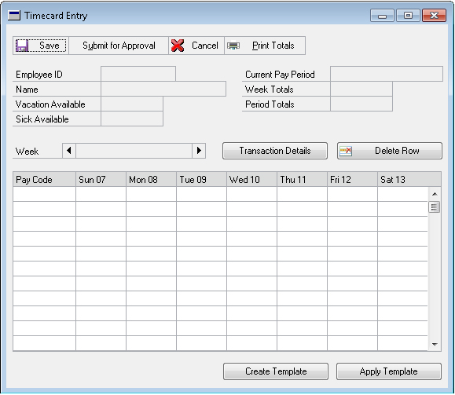
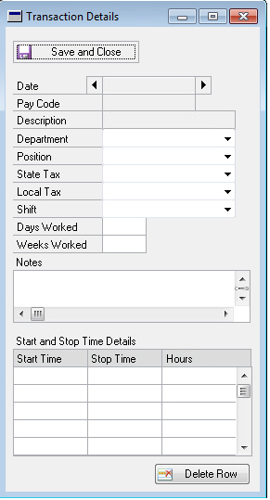
Time Management
Self-Service User
Allows Entering ‘Time on Behalf Of’
Approval Workflow
Notes:
Users are able to enter their own time and we do allow for entering ‘time on behalf of’ another.
Approval based workflows are integrated here.
Additionally, users may define and apply a template—so if you find yourself usually out of the office Friday afternoons you can define such a template.

Slide 59
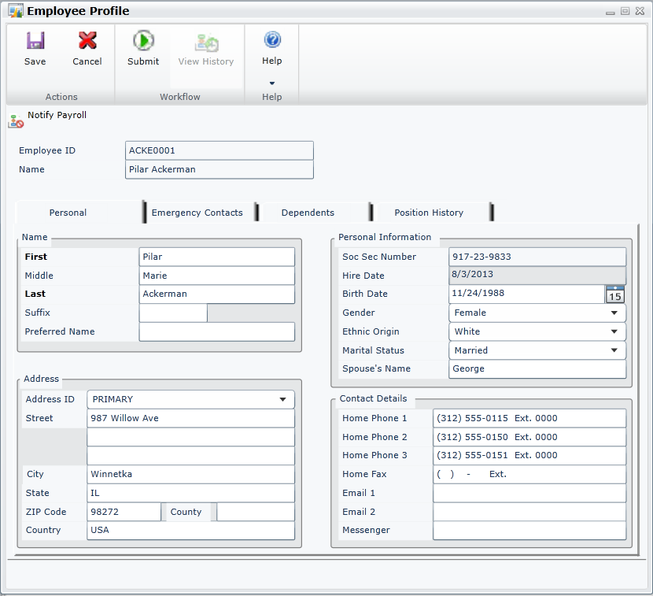
Employee Profile
Employee can view and edit their employment information
Address, Dependents, Emergency Contacts and Position History
Notes:
With employee profile an employee can view and edit their employment information such as address, dependents, emergency contacts, and position history.
A manager may also do this on behalf of an employee.

Slide 60
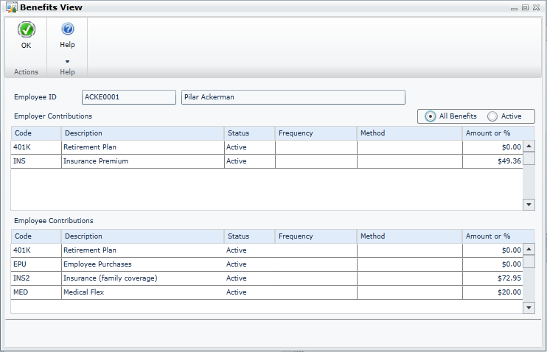
Employee Benefits
Employee can view their benefits with employer and employee contributions
Notes:
Employees can view their benefits which include employer and employee contributions.

Slide 61
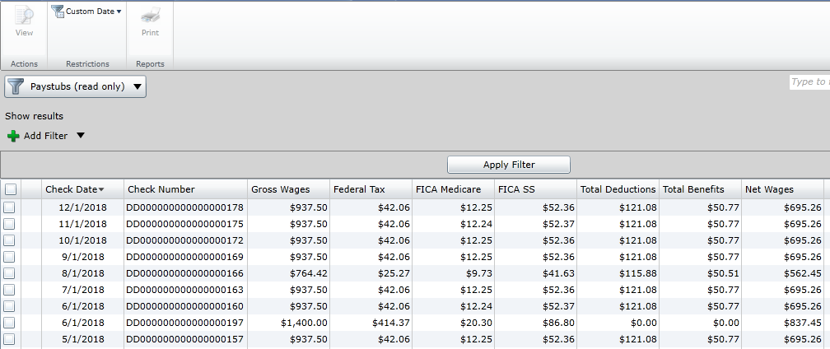
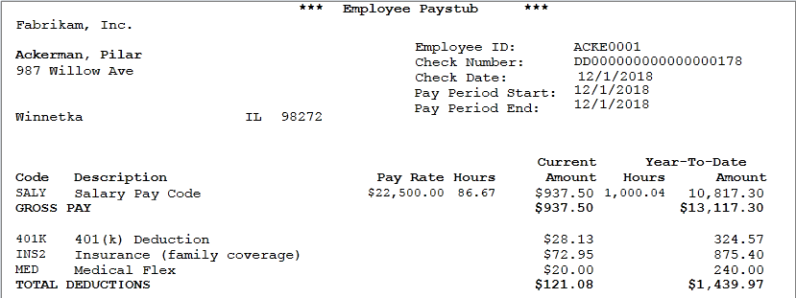
Employee Paystubs
An employee can view or print their paystubs from the paystubs navigation list
Notes:
From a navigation list, employee's can now see and print their paystub.

Slide 62
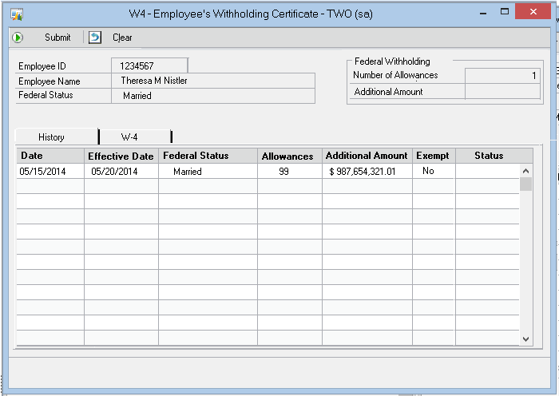
Employee W4
Edit W4 information, add or change additional withholding, and update deductions
Workflow Available
Notes:
Employees can view historical W4 information as well as view and edit current withholding and deductions.
Modifications here utilize approval and or task based workflows.

Slide 63
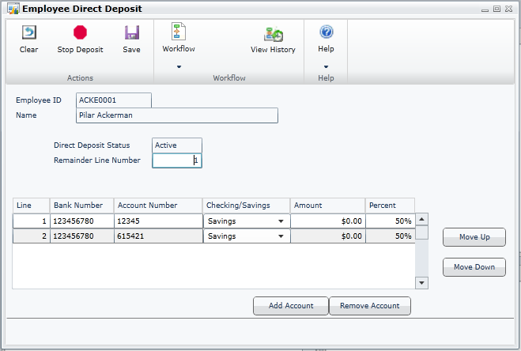
Employee Direct Deposit
Edit deposit information, add accounts or change the distribution
Workflow Enabled
Notes:
With direct deposit an employee may edit their deposit information including multiple accounts and distributions.
A common question here is if a company requires employees to use direct deposit, can they configure the window to remove the ‘Stop Deposit’ button from the ribbon. Answer—not currently. Recommendation here would be to have an approval workflow that would auto reject such a request.

Slide 64
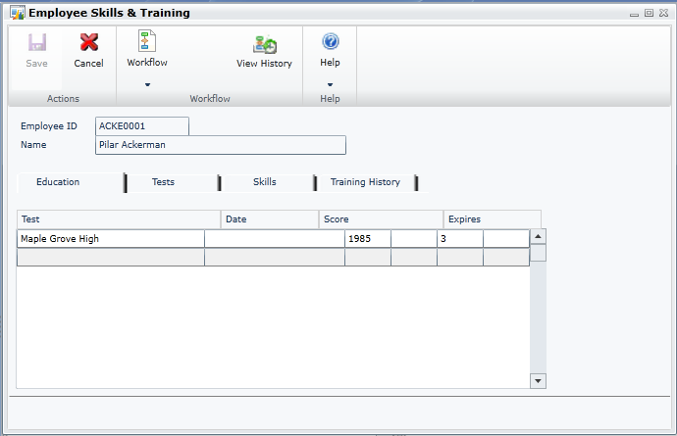
Manager Skills and Training
Manager can view and maintain their employee’s education and tests
View employee’s skills and training history
From navigation lists
Notes:
Lastly, Employee Skills and Training allows managers to view and maintain an employee’s education and tests.
Historical information is also available.

Slide 65
Service Based Architecture – Deep Dive

Slide 66
End Point URI Structure
PATTERN: [Context]/[Resource Path(keys)]?[Query String]
Hypothetical Examples
GET …/Tenants(Default)/Companies(Contoso)/Sales/Customers(AARONFITZ0001)?someflag=true
POST …/Tenants(Default)/Companies(Contoso)/Sales/Customers
DELETE …/Tenants(Default)/Companies(Fabrikam.%20Inc)/Manufacturing/Boms(WIDGET123)
GET …/Tenants(Default)/Companies(Fabrikam.%20Inc)/Products(Id=346)/Boms?limit=20

Slide 67
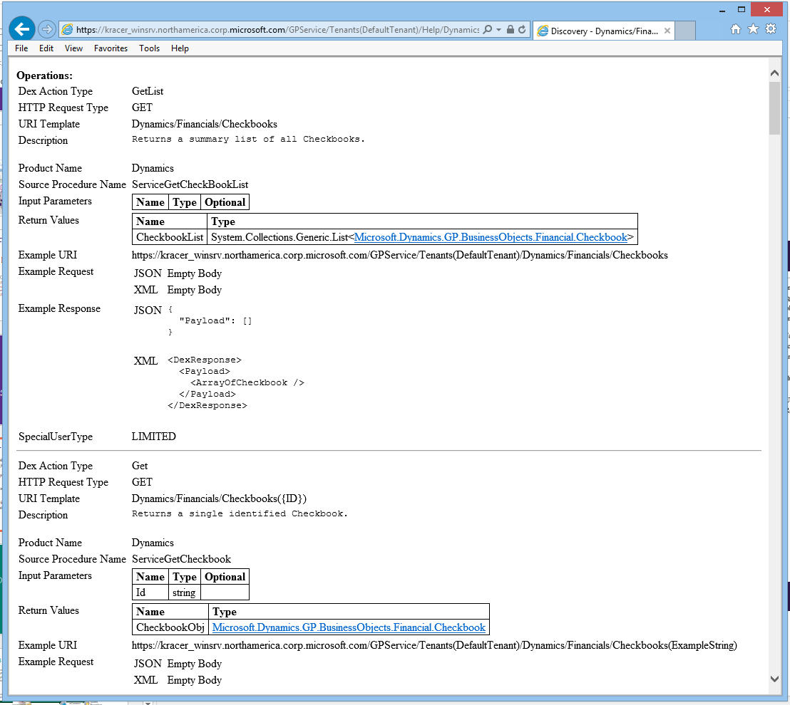
Discover your endpoint
Discover available operations on a live deployment – just add /Help
Use to model your code or extract info from system
Provides info on objects, parameter requirements
Discovery not filtered by security – you may see operations you can’t call
Example URI does not provide company context

Slide 68
Service Call in Action
GET www.FABHosted.com/Services/GPService/Tenants(DefaultTenant)/FieldService/Contracts?Number=‘1234’
Host 1
Products
GP Service
Core GP
Field Service
ISV1
ISV2
Dex Service
GP Instance Tenant1
SQL
Base URL = www.FABHosted.com/Services/GPService
GP Instance Tenant1
Dex Service
Core GP
HR
GP Instance Tenant2
GET www.FABHosted.com/Services/GPService/Tenants(DefaultTenant)/Sales/Orders(BKO98765)
LAN Boundary
Machine Boundary

Slide 69
Acquire a Microsoft Dynamics GP App
Microsoft Dynamics
Microsoft Dynamics GP Time and Attendance
Microsoft Dynamics ISVs
Binary Stream
eOne
Horizons
Ethotech
Encore
Notes:
1 min

Slide 70
Get and analyze data
Office Tools
  Native Excel – Web Queries (xml)
  Power Query – Better tool to leverage REST services
  Power View – awesome visuals from worksheet data
  Power Map – if you have geolocation data
Portable and Secure
  Authentication built in
  Encryption end to end
Notes:
2 min

Slide 71



Build an app
Visual Studio
Sienna
Other Platform Tools
Custom app with Visual Studio
- Microsoft Dynamics GP helper in Visual Studio next
Sienna
Consumer/end user tool
Free
Builds Windows 8 apps
Needs to support
http (web) requests
JSON or XML
Windows or Org Identity
PostMan app in Chrome
Notes:
1.5 min

Slide 72

What’s behind an operation?
Dexterity sanScript + .NET interop
New global procedure type - Service Procedure
Added properties describe operation
Documentation – flows through to Discovery

Slide 73
Service Procedure Properties
Action – maps to http verbs + custom POST option
CustomAction – tag to identify a non crud operation
Enabled – DAG recognizes if TRUE
RawRequest – you get the raw html stream
URI Template – resource path used to invoke and bind non managed parameters
Special User Type – available to limited users
Notes:
Custom action header field = “GP-Custom-Action” and whatever value you put here.
Keep in mind we only template the part of the URI prior to the ? Anything beyond that is optional.

Slide 74
Developer Experience
Create any .NET objects for data I/O
Create your Service Procedure(s)
Use DAG to create your assembly
Chunk Dictionary
Deploy your assembly alongside the dictionary

Slide 75


Slide 76

Security
Fully Encrypted with SSL
Consumers must be a GP User with AD or Org Account mapped
Roles/Tasks authorize operations

Slide 77
Security Flow
Windows
OR
Azure AD
Authenticate “bob”
Host 1
bob@somedomain.com
GP Service
Dexterity Service
GP Process Tenant1
Service Consumer
SQL
GP Process Tenant1
SSL Encrypted
Dexterity Service
GP Process Tenant2
Is “bob” in Tenant2?
Tenant Service
Is “bob” a GP User and can he access this procedure?

Slide 78






Microsoft Dynamics GP Services – V1
Microsoft Dynamics GP Web Services
Based on SOAP protocol with XML ‘documents’ as a payload
Underlying logic was eConnect sql procedures (duplicated from client)
Security was standalone and separately configured (could be ‘synched’ to Microsoft Dynamics GP)
.NET object serialized to XML and put in SOAP envelope sent to endpoint
.NET object de-serialized back to .NET object which is then mapped to an eConnect call
WCF used to call method providing .NET object as data
eConnect
Stored Procedure executed
Notes:
1 min

Slide 79
Service based architecture advantages
Uses the language of the Web
  Many tools and off the shelf apps support REST
  Http protocol supported by most development languages
Leverages dexterity and existing logic
Integrated security + encryption
  SSL – communications encrypted end to end
  Users are in the GP System – one place to maintain users
  Security by role
Discovery
Notes:
2 min

Slide 80
Parts included, some assembly required
Included on install media under Web Components
  Do not have to install Web Client
  Can install side by side with Web Client (same machine)
No additional license needed
  Users will need to have a Microsoft Dynamics GP User/license
Requires an SSL Certificate
Deployment guide available
Web Management Console
Notes:
2 min 47.5

Slide 81
Partner Benefits
Companion/Mobile app opportunities
A recent survey by Vision Mobile found that just 16% of worldwide developers are building mobile apps for enterprises
Ability to leverage managed code
Integrate to any desired GP functionality
CRUD & non CRUD operations
Maintain existing Dexterity investments

Slide 82
“reIMAGINE the possibilities”
This is more than just a bunch of web services
  It’s a framework
  It’s an enabler
Think broadly first then narrow your focus
Anything that benefits from mobility is a candidate

